Slide 1

Linking Longitudinal Studies of Ageing with
Administrative Data
Anne Gasteen, Elaine Douglas, David Bell
British & Irish Longitudinal Studies of Ageing (BILS) Meeting
3-4 February 2020

Slide 2
The Project
Funded by the ESRC’s Centre for Population Change (CPC)
Living longer and the Changing Lifecourse
Remit: To evaluate the administrative data linkage of the surveys belonging to the Health and Retirement Studies (HRS) family on the Gateway to Global Ageing (GGA) platform
Notes:
Part of the Living Longer and the Changing Lifecourse research strand

Slide 3
Discovering What’s Out There [1]
Mapping of HRS family surveys to provide initial overview of use
Mapping and comparison of surveys’ linked data content:
  Review of metadata
    Methodology, sampling frame
    Nature of link / accuracy (direct link / matching)
    Selection bias
    Additional information/variables
Notes:
Mapping of HRS family surveys to provide initial overview of use:
Which surveys are / have been linked to admin data and what are they linked to (health records, tax/benefits/pension info, education) and years of linkage
Which surveys will be / have the potential to be linked to admin data
Systematic review of metadata.
Not always clear, so …..

Slide 4
Discovering What’s Out There [2]
Survey of HRS Studies’ PIs
Review of Outputs (papers) using admin data housed in GGA publications’ repository
Survey of researchers using linked studies
Notes:
Review of Outputs (papers) using admin data housed in GGA publications’ repository
Coverage of repository? General lit search?
CLOSER (2019) Report (p23): Studies rely on users to tell them how they use the data in order to begin tracking impact. Challenges in tracking data use differ according to access model of study. Studies that req users to apply and/or pay for data can enforce reporting requirements for users. With open access models, users agree to terms of end user licence which includes reporting reqs but these are ‘much more’ difficult to enforce.
Survey of researchers/users – particularly interested in those outside main research teams. Need to broaden research base to promote resonance.

Slide 5
Why and how linkage/use differs
Ethical consents:
  GDPR interpretation
  Specific domestic legislation determining government departments’ use of data
Access conditions
  Approval processes, training, physical access
  Map application processes and requirements across studies/countries
Notes:
Explore data governance (lit review?). Review relevant legislation and regulations.
Consent for linkage = major challenge (CLOSER2020).

Slide 6
Should HRS Linkages be enhanced? And, if so, how?
Assessment of value added of the admin data linkages and their potential future role in the development of longitudinal studies of ageing
  Evaluation criteria?
  Method: Cost Benefit Analysis? Capitals’ approach? Research ‘value chain’?
Identify potential improvements in accuracy of linkages / info retrieval / access
Notes:
Assessment of the value of these admin data linkages and the potential future role they might play in the development of longitudinal studies of ageing
Evaluation criteria?
Method: Cost Benefit Analysis? Capitals’ approach? Research ‘value chain’?
Community Capitals Framework (CCF) = approach to analyse communities and community development efforts from a systems’ perspective. Communities found to be effective in supporting economic development focussed on 7 types of capital (Flora & Flora, 2013): Natural capital, Cultural capital, Human capital, Social capital, Political capital, Financial capital, Built capital. CCF focusses on community assets - can be un-/under-used and invested to generate more assets.
CCF Research Model:
Context: pre-existing Conditions & Structures -> Process: Actions, Investments, Interventions -> Outputs & Outcomes: Results of actions
Identify potential improvements in accuracy of linkages / info retrieval / access – last CLOSER conf paper? **

Slide 7
Administrative Data Linkage
Value Chain
Data
Insight
Action
Application / Approval
Access
Processing & Analysis
Data Use, Outputs & Impact
Notes:
3 key challenges: Time, Comparability (across cohorts & internationally), Resonance (with policymakers) [CLOSER2020]. Value of longitudinal studies (and linkage) accrues over time, extensive investment to set up. Making data more accessible across the board takes time. Challenges of retaining research expertise & participants. Discoverability, visibility, access – broadening research base to promote resonance.
Application/Approval: need better buy-in from providers. Providers would gain evidence base for policy / impact of interventions but … Biggest challenge = ‘real time’ data linkage for policy (ADR2019). [Ministers respond to public mood, academics need to make case to public that linkage/better use of data improves lives.]
Access: Current long-lead time (as discussed CLOSER 2019), successful acquisition takes time (not always reflected in study funding periods) + …
Processing: Cleaning data to link and evaluation of quality of linkage. Need to change culture around collection of admin data (again provider buy-in). Need standardisation of collection, de-identification and linkage (ADR2019). Reliability and evaluation of de-ident methods (ibid). ‘Minimax’ principle for value of admin data: need to ‘simultaneously minimise distance from point of data production while maximising data’s representation of mechanism that produces [desired] outcomes’ (how far can you move away from individual before identifying policy solution).
Data Use, Outputs & Impact: Ideally, want datasets that are linked once and used many times (change in ADR Scotland model from create/destroy to data held in research-ready state) => Extraction of value from utilising data/subsequent outputs.
Impact path: Activity (research) -> Output (eg paper) -> Outcome (a change) => Impact

Slide 8
Proposed Outputs
Series of Interim Reports / academic papers
Final Comprehensive Report
Update-able reference resource for CPC/GGA; catalogue of HRS admin data linkages/how to access?
Notes:
Book? Other contributors? (History/origins of using/linking admin data, China?)

Slide 9
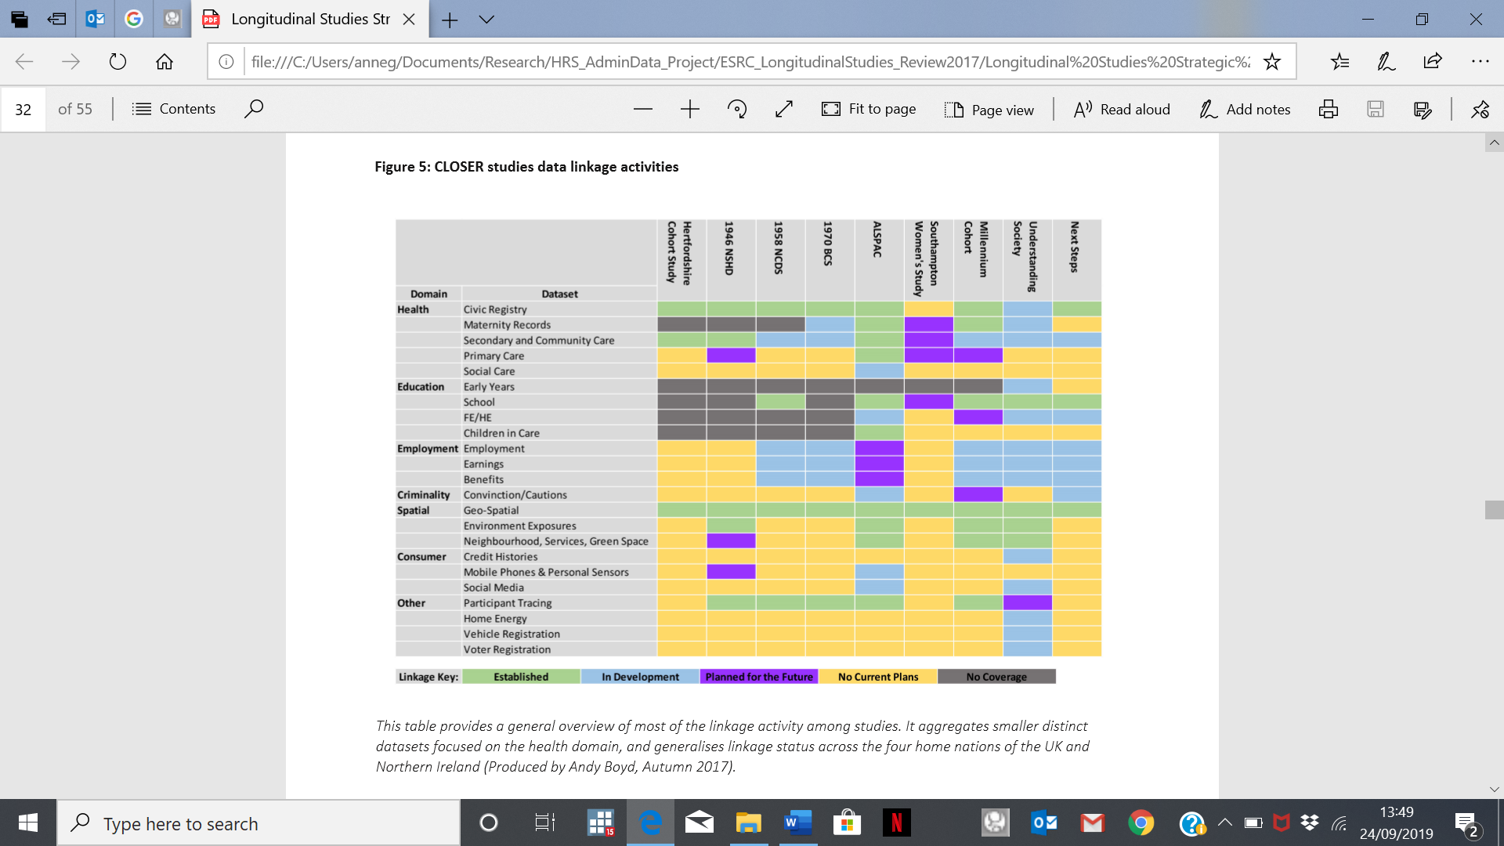
CLOSER Studies’ Linkage Map

Slide 10
HRS Studies’ Linkage Map to-date
Notes:
Table = Studies where GGA has produced harmonised data
Other Sister Studies: Indonesian Family Life Survey (IFLS), Study on Global AGEing & Adult Health (SAGE), The Health and Aging Study in Africa (HAALSI), Healthy Ageing in Scotland (HAGIS), Northern Ireland Cohort for the Longitudinal Study of Ageing (NICOLA), The Brazilian Longitudinal Study of Aging (ELSI), Health, Aging and Retirement in Thailand (HART), Malaysia Aging and Retirement Survey (MARS)
Consensus that for HRS family, linkage may be relatively poorly developed compared to (general) cohort studies but harmonization is much better (facilitated by GGA).

Slide 11
Thank you!

